Slide 1
Presentation for “Late Night Snack”
Matthew Yanzer

Slide 2
Why did I decide to make this project?
First, game design has always intrigued me.
Second, I enjoy the process of game design.

Slide 3
What is my senior project?(1)
“Late Night Snack”
Two goals
Soda Ending
Weapon Ending

Slide 4
What is my senior project?(2)
Losing Conditions
Random AI
Chasing AI
Alarm AI

Slide 5
Original Idea
Blender
Unreal Engine
Blueprints

Slide 6
Why did my software change from Unreal to and Blender to C++?
Lack of knowledge about Unreal.
Difficult to test in.
Time consuming.

Slide 7
How was C++ used?
Threat AI
Environment/maze
Player’s controls
Interactive objects
Menu selection

Slide 8
olc Console Game Engine
Engine style
Developed by One Lone Coder
https://www.youtube.com/channel/UC-yuWVUplUJZvieEligKBkA

Slide 9
Sprite Editor
Making sprites for the game
Utilizes unique .spr file
Also made by One Lone Coder

Slide 10
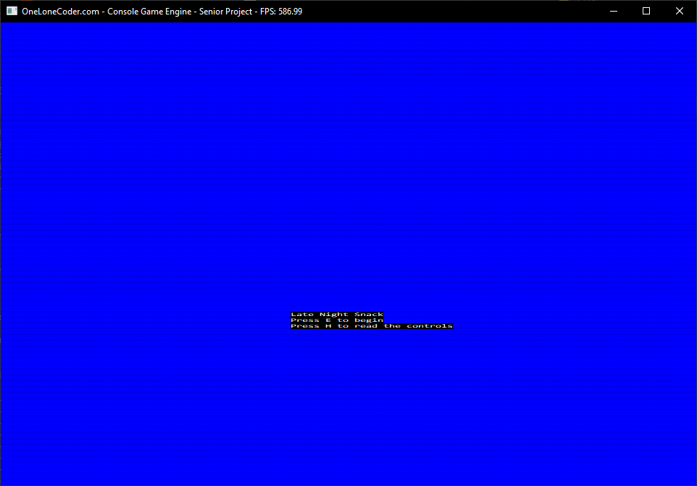
Screenshot of Title Screen

Slide 11
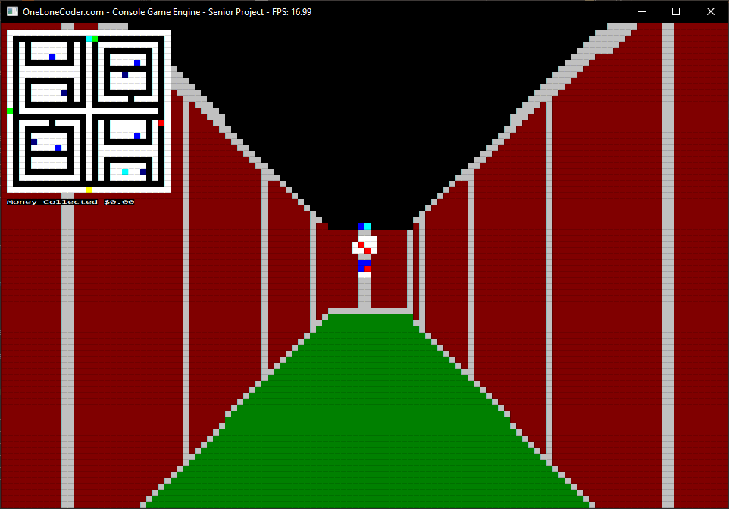
Screenshot of Gameplay

Slide 12
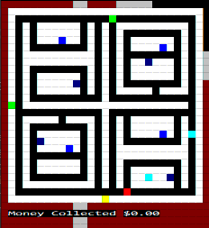
Screenshot of Map

Slide 13
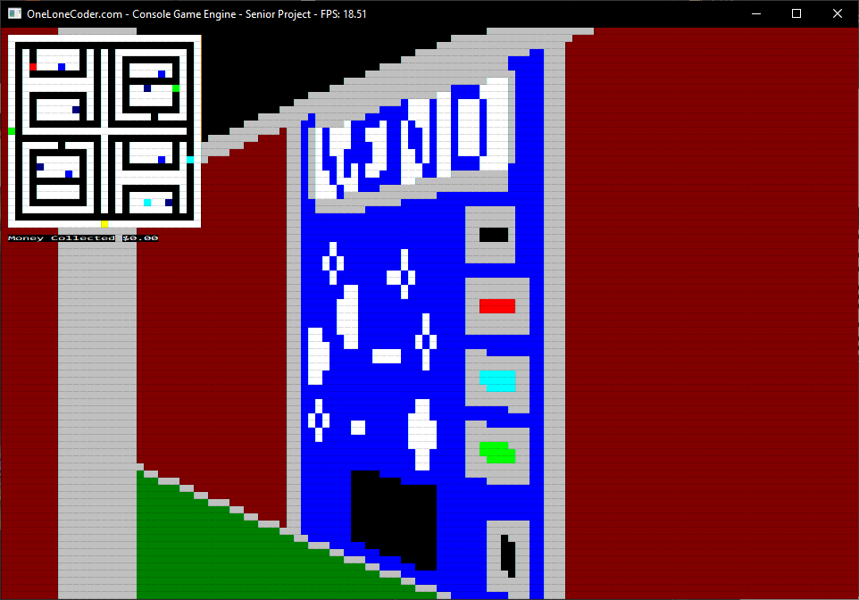
Screenshot of Vending Machine

Slide 14
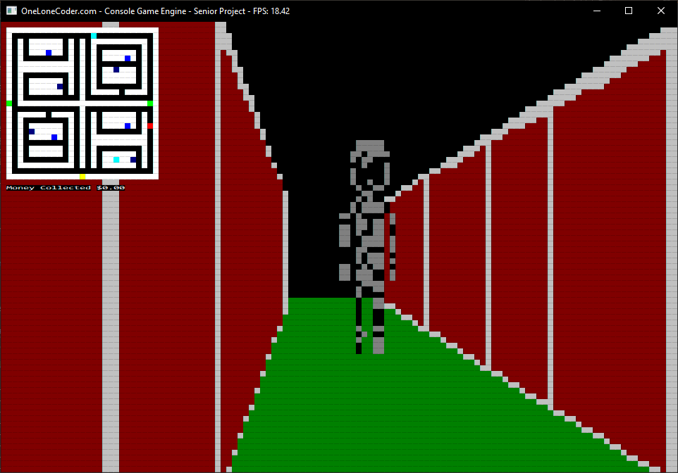
Screenshot of Threat

Slide 15
How did I test my project?
My project was tested in two ways; unit testing and play testing.
unit testing
play testing
Proper AI behavior
Ability to properly control player
Successful interactions with environment
Correct displays

